Slide 1
Achieving the Dream
Opening Session
October 5, 2011
Sonya Christian

Slide 2
Outcomes
As a result of each workshop participants will:
be able to analyze and interpret existing data at the division, discipline and course levels with the intention of revising practices to improve student success.
understand and be conversant with the objectives, indicators of achievement, and scorecard for mission fulfillment that comprise Lane’s new accreditation framework.
learn how they can contribute to strengthening Lane's culture of evidence, moving toward a student-centered perspective in addition to a unit-centered perspective.
develop meaningful data-based questions for future exploration and analysis.

Slide 4
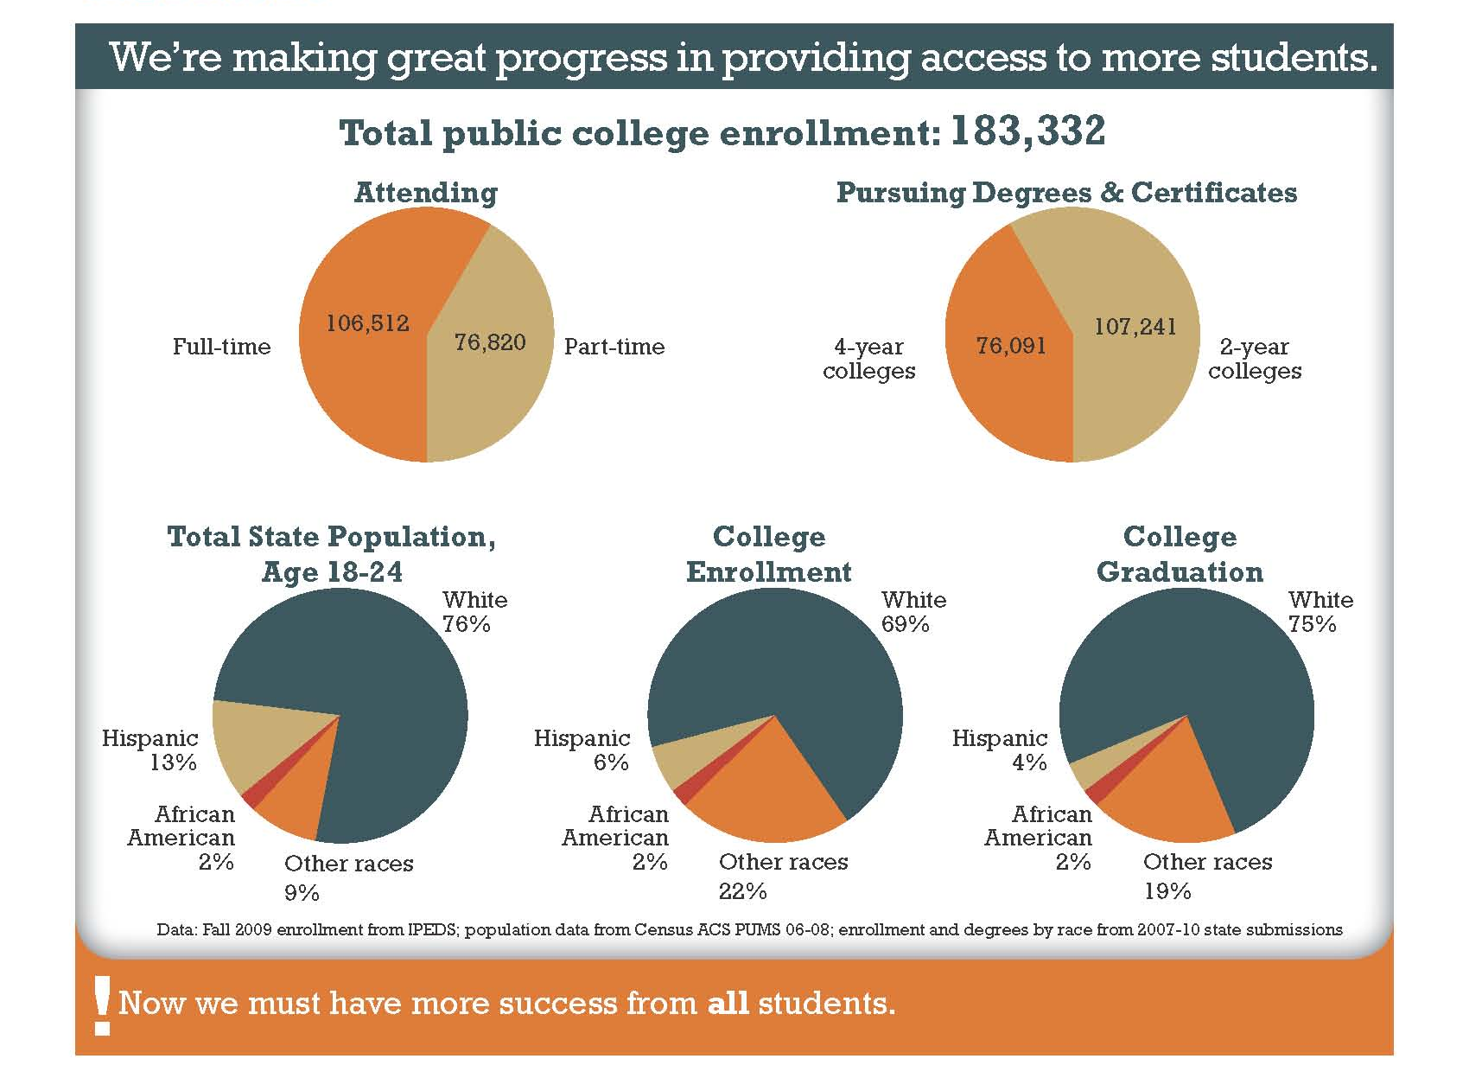

Slide 7
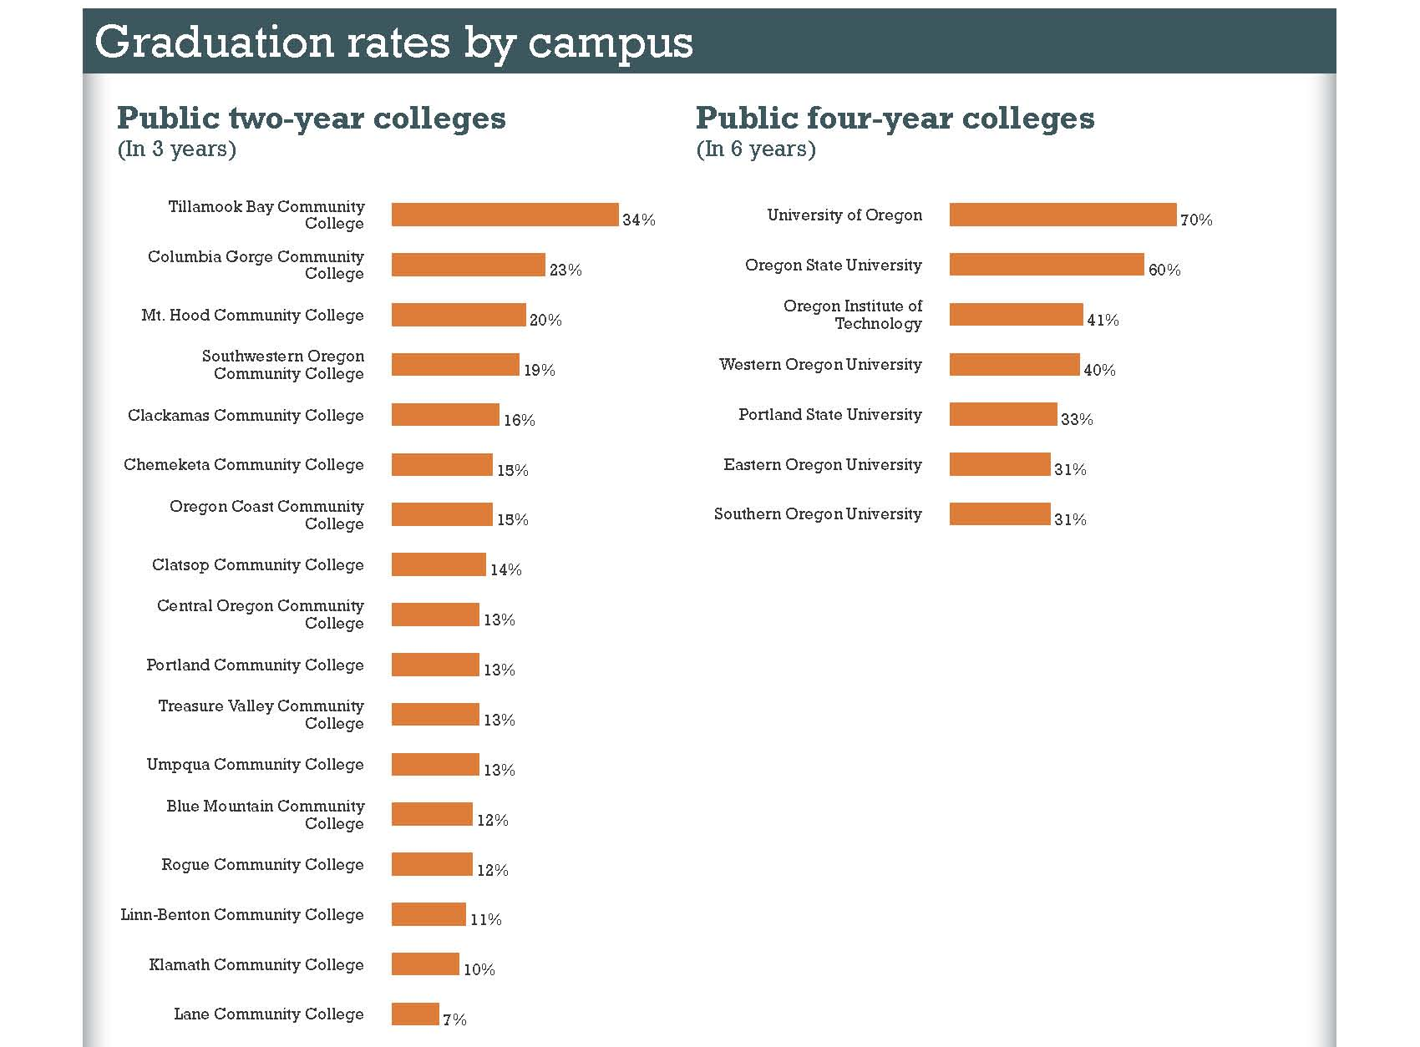

Slide 8
It is all about student success
Just progression degree and certificate completion
NOT!
“What” have they learned?
“What” can they do?

Slide 9
Student Success
Quality Progression and Completion

Slide 10
Mission
Lane is the community’s college;
we provide comprehensive, accessible, quality, learning-centered
educational opportunities that
promote student success.
It is all about student success

Slide 11
Mission Fulfillment
Mission
Career Technical Education & Workforce Development
Core Themes
Academic
Transfer
Foundational
Skills
Community
Education
Strategic
Directions
External
Forces
Internal Forces

Slide 12
How do we know?
Through our Core Theme Indicators of Achievement
Objective A:
When they are with us
Objective B:
After they leave us
Objective C:
Accessible, quality, learning centered

Slide 13
Mandatory/Online
Advising & Orientation
Roadmaps
Open Educational Resources
Title III:
Engaging Students
Degree Qualifications Profile
Democracy Commitment
Islam Initiative
CAPP Degree Audit
Automation
Win-Win
Pathways
Foundations of
Excellence
ABE to Credential
Honors Program

Slide 14
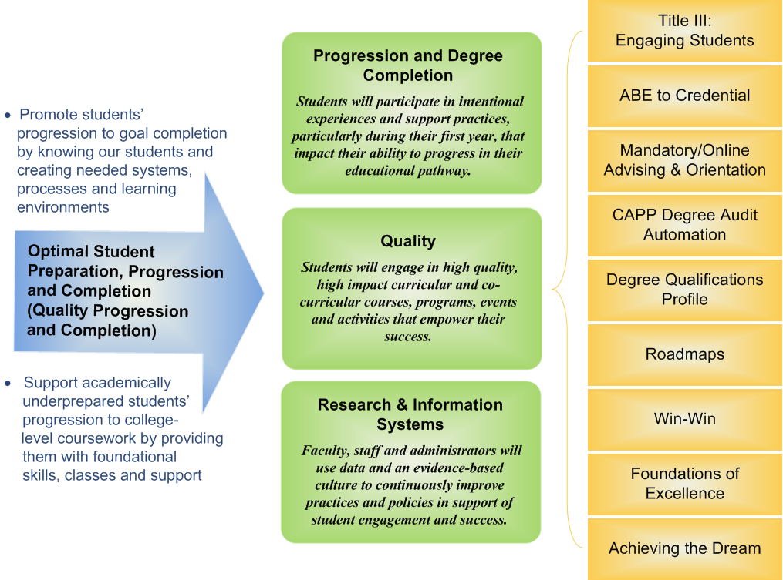
Strategic Direction Strategic Initiatives Institutional Projects

Slide 16
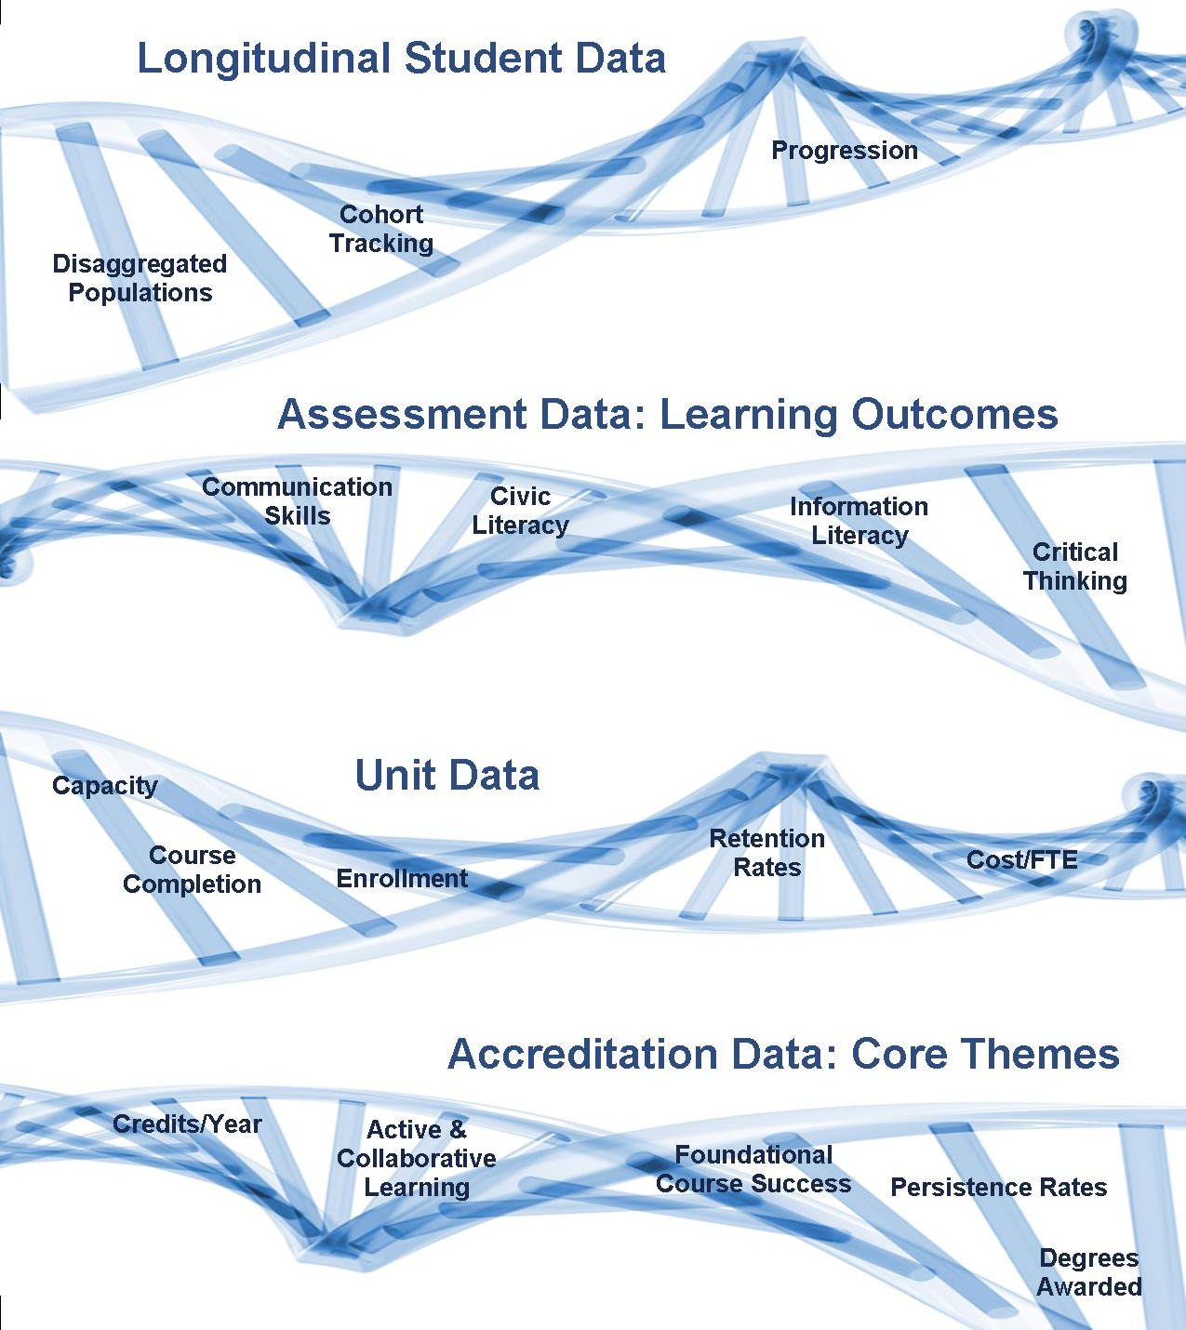
Spring 2012 data coaches Fall 2012 campus launch
Student Learning Assessment
Have this info
Use if for planning
Will have this info by Dec 2011

Slide 17
An example: Accreditation Core Theme Indicators Academic Transfer: 1.14 to 1.18 Career Technical: 2.15 to 2.19 Foundational Skills: 3.10 to 3.13
CCSSE

Slide 18
Some CCSSE data
Challenging intellectual and creative work is central to student learning and collegiate quality. Ten survey items address the nature and amount of assigned academic work, the complexity of cognitive tasks presented to students, and the standards faculty members use to evaluate student performance.

Slide 19
Some CCSSE data
Academic Challenge | Lane | Oregon Cohort | Large US Colleges
In your experiences at this college during the current school year, about how often have you done each of the following? | 1 = Never, 2 = Sometimes, 3 = Often, 4 = Very often
Worked harder than you thought you could to meet an instructor's standards or expectations | 2.66 | 2.67 | 2.66
During the current school year, how much has your coursework at this college emphasized the following mental activities? | 1 = Very little, 2 = Some, 3 = Quite a bit, 4 = Very much
Analyzing the basic elements of an idea, experience, or theory | 3.05 | 2.96 | 2.97
Synthesizing and organizing ideas, information, or experiences in new ways | 2.91 | 2.83 | 2.84
Making judgments about the value or soundness of information, arguments, or methods | 2.74 | 2.70 | 2.71
Applying theories or concepts to practical problems or in new situations | 2.83 | 2.78 | 2.78
Using information you have read or heard to perform a new skill | 2.96 | 2.89 | 2.87

Slide 20
Some CCSSE data
Academic Challenge | Lane | Oregon Cohort | Large US Colleges
During the current school year, about how much reading and writing have you done at this college? | 1 = None, 2 = Between 1 and 4, 3 = Between 5 and 10, 4 = Between 11 and 20, 5 = More than 20
Number of assigned textbooks, manuals, books, or book-length packs of course readings | 3.26 | 3.13 | 3.12
Number of written papers or reports of any length | 3.24 | 3.19 | 3.20
Mark the box that best represents the extent to which your examinations during the current school year have challenged you to do your best work at this college | 1 = Extremely easy ... 7 = Extremely challenging
 | 5.06 | 5.03 | 4.99
How much does this college emphasize each of the following? | 1 = Very little, 2 = Some, 3 = Quite a bit, 4 = Very much
Encouraging you to spend significant amounts of time studying | 3.15 | 3.07 | 3.06

Slide 21
Some CCSSE data
Academic Challenge | Lane | Oregon Cohort | Large US Colleges
In your experiences at this college during the current school year, about how often have you done each of the following? | 1 = Never, 2 = Sometimes, 3 = Often, 4 = Very often
Worked harder than you thought you could to meet an instructor's standards or expectations | 2.66 | 2.67 | 2.66
During the current school year, how much has your coursework at this college emphasized the following mental activities? | 1 = Very little, 2 = Some, 3 = Quite a bit, 4 = Very much
Analyzing the basic elements of an idea, experience, or theory | 3.05 | 2.96 | 2.97
Synthesizing and organizing ideas, information, or experiences in new ways | 2.91 | 2.83 | 2.84
Making judgments about the value or soundness of information, arguments, or methods | 2.74 | 2.70 | 2.71
Applying theories or concepts to practical problems or in new situations | 2.83 | 2.78 | 2.78
Using information you have read or heard to perform a new skill | 2.96 | 2.89 | 2.87

Slide 22
Some CCSSE data
Academic Challenge | Lane | Oregon Cohort | Large US Colleges
During the current school year, about how much reading and writing have you done at this college? | 1 = None, 2 = Between 1 and 4, 3 = Between 5 and 10, 4 = Between 11 and 20, 5 = More than 20
Number of assigned textbooks, manuals, books, or book-length packs of course readings | 3.26 | 3.13 | 3.12
Number of written papers or reports of any length | 3.24 | 3.19 | 3.20
Mark the box that best represents the extent to which your examinations during the current school year have challenged you to do your best work at this college | 1 = Extremely easy ... 7 = Extremely challenging
 | 5.06 | 5.03 | 4.99
How much does this college emphasize each of the following? | 1 = Very little, 2 = Some, 3 = Quite a bit, 4 = Very much
Encouraging you to spend significant amounts of time studying | 3.15 | 3.07 | 3.06

Slide 23
Some CCSSE data
Students learn more when they are actively involved in their education and engage in joint educational efforts with other students. The active and collaborative learning benchmark measures
the extent to which students participate in class, interact
with other students, and extend learning outside of the
classroom.

Slide 24
Some CCSSE data
Active and Collaborative Learning | Lane | Oregon Cohort | Large US Colleges
In your experiences at this college during the current school year, about how often have you done each of the following? | 1 = Never, 2 = Sometimes, 3 = Often, 4 = Very often
Asked questions in class or contributed to class discussions | 3.10 | 2.98 | 2.94
Made a class presentation | 2.19 | 2.28 | 2.29
Worked with other students on projects during class | 2.74 | 2.60 | 2.58
Worked with classmates outside of class to prepare class assignments | 2.09 | 2.06 | 2.05
Tutored or taught other students (paid or voluntary) | 1.54 | 1.47 | 1.46
Participated in a community-based project as a part of a regular course | 1.35 | 1.39 | 1.39
Discussed ideas from your readings or classes with others outside of class (students, family members, co-workers, etc.) | 2.80 | 2.63 | 2.62

Slide 25
Some CCSSE data
Students’ behaviors contribute significantly to their learning and the likelihood that they will attain their educational goals. The student effort benchmark measures time on task, preparation, and use of student services.

Slide 26
Some CCSSE data
Student Effort | Lane | Oregon Cohort | Large US Colleges
In your experiences at this college during the currentschool year, about how often have you done each of the following? | 1 = Never, 2 = Sometimes, 3 = Often, 4 = Very often
Prepared two or more drafts of a paper or assignment before turning it in | 2.72 | 2.65 | 2.65
Worked on a paper or project that required integrating ideas or information from various sources | 2.97 | 2.96 | 2.98
Came to class without completing readings or assignments | 1.88 | 1.89 | 1.92
During the current school year, about how much reading and writing have you done at this college? | 1 = None, 2 =1 to 4, 3 = 5 to 10, 4 = 11 to 230, 5 = 20+
Number of books read on your own (not assigned) for personal enjoyment or academic enrichment | 2.24 | 2.11 | 2.12

Slide 27
Some CCSSE data
Student Effort | Lane | Oregon Cohort | Large US Colleges
About how many hours do you spend in a typical 7-day week doing each of the following? | 0 = None, 1 = 1-5 hours, 2 = 6-10, 3 = 11-20, 4 = 21-30, 5 = 30+
Preparing for class (studying, reading, writing, rehearsing, doing homework, or other activities related to your program) | 2.70 | 2.20 | 2.19
How often you use the following services? | 1 = Rarely/Never, 2 = Sometimes, 3 = Often
Frequency: Peer or other tutoring | 1.62 | 1.52 | 1.52
Frequency: Skill labs (writing, math, etc.) | 1.70 | 1.78 | 1.75
Frequency: Computer lab | 1.97 | 2.20 | 2.18

Slide 28
How do we build our data and analysis literacy?

Slide 29
New
Researcher
IRAP
(Craig and Sylvia)
Data
Coaches
Data
Coaches
Faculty
Researcher
Campus Community

